Slide 1

APEX INSTITUTE OF TECHNOLOGY
DEPARTMENT OF COMPUTER SCIENCE & ENGINEERING
Computer Organization & Architecture (21CSH-281)
Faculty: Siddharth Kumar (E12853)
Lecture – 27 & 28
Memory Organization: Mapping Functions
DISCOVER . LEARN . EMPOWER

Slide 2
Computer Organization & Architecture: Course Objectives
COURSE OBJECTIVES
The course aims to:
The purpose of the course is to introduce principles of computer organization and the basic architectural concepts.
It begins with basic organization, design, and programming of a simple digital computer and introduces simple register transfer language to specify various computer operations.
Topics include computer arithmetic, instruction set design, microprogrammed control unit, pipelining and vector processing, memory organization and I/O systems, and multiprocessors.
To familiarize Students with the detailed Architectures of a Central Processing Unit.
Learn the different types of serial communication techniques.

Slide 3
COURSE OUTCOMES
On completion of this course, the students shall be able to:-
CO1 | Identify and interpret the basics of instruction sets and their impact on the design, organization, and functionality of various functional units of a computer comparable to the CPU, memory organization, I/O organization, and parallel processors.
CO2 | Analysis of the design of arithmetic & logic unit and understanding of the fixed point and floating-point arithmetic operations.
CO3 | Relate cost performance and design trade-offs in designing and constructing a computer processor which includes memory.
CO4 | Understanding the different ways of communicating with I/O devices and standard I/O interfaces.
CO5 | Implementation of control unit techniques and the concept of Pipelining.

Slide 4
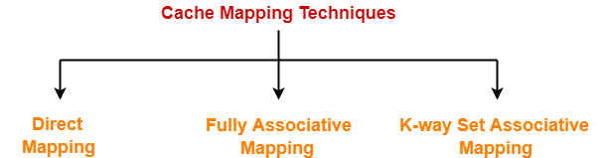
Mapping Functions
There are three different types of mapping used for the purpose of cache memory which are as follows:
Direct mapping,
Associative mapping
Set-Associative mapping
Direct Mapping: In direct mapping, the cache consists of normal high-speed random-access memory. Each location in the cache holds the data, at a specific address in the cache. This address is given by the lower significant bits of the main memory address. This enables the block to be selected directly from the lower significant bit of the memory address. The remaining higher significant bits of the address are stored in the cache with the data to complete the identification of the cached data.

Slide 5
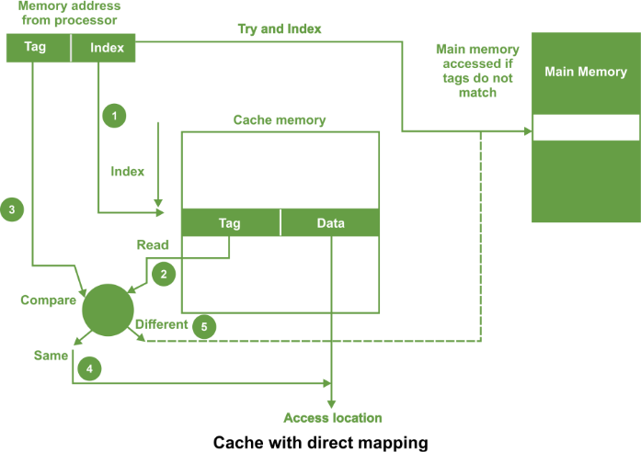
As shown in the above figure, the address from processor is divided into two field a tag and an index.

Slide 6
The tag consists of the higher significant bits of the address and these bits are stored with the data in cache. The index consists of the lower significant b of the address.
Whenever the memory is referenced, the following sequence of events occurs
The index is first used to access a word in the cache.
The tag stored in the accessed word is read.
This tag is then compared with the tag in the address.
If two tags are same this indicates cache hit and required data is read from the cache word.
If the two tags are not same, this indicates a cache miss. Then the reference is made to the main memory to find it.
For a memory read operation, the word is then transferred into the cache. It is possible to pass the information to the cache and the process simultaneously.

Slide 7
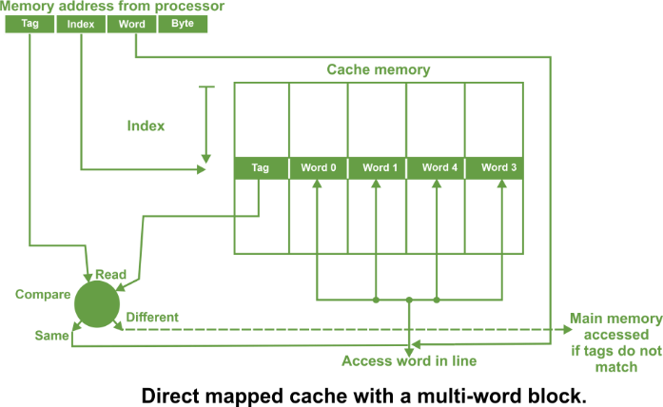
In direct mapped cache, there can also be a line consisting of more than one word as shown in the following figure

Slide 8
In such a case, the main memory address consists of a tag, an index and a word within a line. All the words within a line in the cache have the same stored tag
The index part in the address is used to access the cache and the stored tag is compared with required tag address.
For a read operation, if the tags are same, the word within the block is selected for transfer to the processor. If tags are not same, the block containing the required word is first transferred to the cache.
In direct mapping, the corresponding blocks with the same index in the main memory will map into the same block in the cache, and hence only blocks with different indices can be in the cache at the same time.
It is important that all words in the cache must have different indices.
The tags may be the same or different.
Set Associative Mapping: In set associative mapping a cache is divided into a set of blocks. The number of blocks in a set is known as associativity or set size. Each block in each set has a stored tag. This tag together with index completely identify the block.

Slide 9
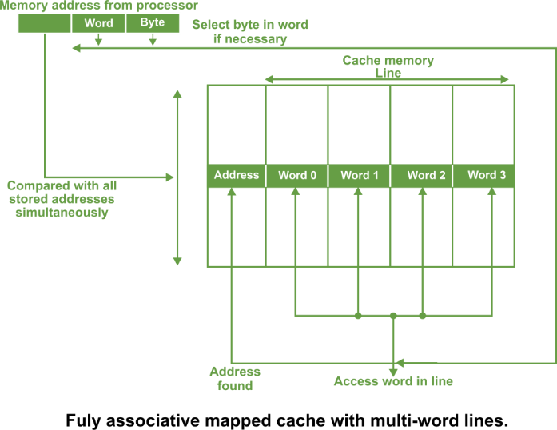
Thus, set associative mapping allows a limited number of blocks, with the same index and different tags. An example of four way set associative cache having four blocks in each set is shown in the following figure

Slide 10
In this type of cache, the following steps are used to access the data from a cache:
The index of the address from the processor is used to access the set.
Then the comparators are used to compare all tags of the selected set with the incoming tag.
If a match is found, the corresponding location is accessed.
If no match is found, an access is made to the main memory.
The tag address bits are always chosen to be the most significant bits of the full address, the block address bits are the next significant bits and the word/byte address bits are the least significant bits.
The number of comparators required in the set associative cache is given by the number of blocks in a set.
The set can be selected quickly and all the blocks of the set can be read out simultaneously with the tags before waiting for the tag comparisons to be made.
After a tag has been identified, the corresponding block can be selected.

Slide 11
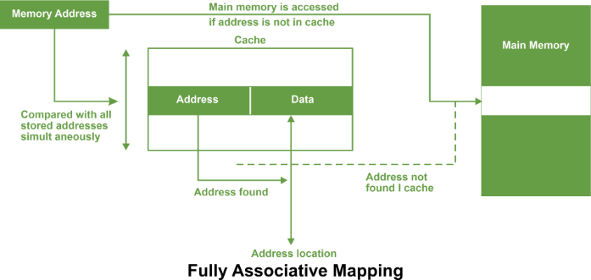
Fully associative mapping: In fully associative type of cache memory, each location in cache stores both memory address as well as data.

Slide 12
Whenever a data is requested, the incoming memory address a simultaneously compared with all stored addresses using the internal logic the associative memory. If a match is found, the corresponding is read out. Otherwise, the main memory is accessed if address is not found in cache.
This method is known as fully associative mapping approach because cached data is related to the main memory by storing both memory address and data in the cache. In all organizations, data can be more than one word as shown in the following figure.

Slide 13
A line constitutes four words, each word being 4 bytes. In such case, the least significant part of the address selects the particular byte, the next part selects the word, and the remaining bits form the address. These address bits are compared to the address in the cache.
The whole line can be transferred to and from the cache in one transaction if there are sufficient data paths between the main memory and the cache. With only one data word path, the words of the line have to be transferred in separate transactions.
The main advantage of fully associative mapped cache is that it provides greatest flexibility of holding combinations of blocks in the cache and conflict for a given cache.
It suffers from certain disadvantages:
It is expensive method because of the high cost of associative memory.
It requires a replacement algorithm in order to select a block to be removed whenever cache miss occurs.
Such an algorithm must be implemented in hardware to maintain a high speed of operation.
The fully associative mechanism is usually employed by microprocessors with small internal cache.

Slide 14
Summary
Discussed about the Cache memory mapping.
Assessment Questions
Q1. What are the types of Cache memory mapping ?

Slide 15
THANK YOU

